Slide 1

Viahart ChatBots
Group 9
Tony Xu
Yichen Yu
Xiaorong Tian
Yifan Lu

Slide 2
Outlines
Overview
Scenario 1
Scenario 4
Advantages
Scenario 2
APIs
Project objective
Scenario 3
Conclusion

Slide 3
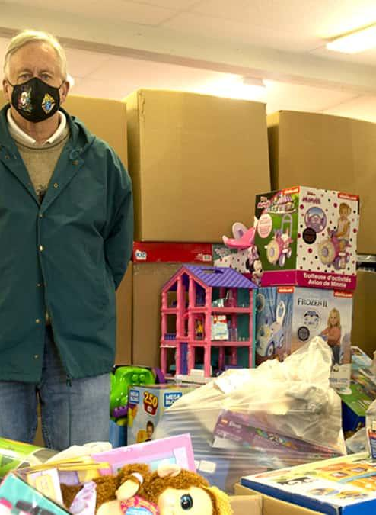
Viahart Overview
Viahart is a prominent DTC toy and educational product company renowned for its innovative designs and unwavering commitment to quality. With a product range that spans from plush toys to brain-challenging puzzles, Viahart ensures that every item they produce balances both educational value and playful engagement. With a wide range of product selection and a customer base ranging from individual customer to wholesalers, Viahart needs a way to help streamline its ordering process.

Slide 4
Advantages of the ChatBot
Ease for Conducting Market Research: Gather information regarding what the customers need, get a better picture on the company’s product profile and what can be improved. More Interaction
24/7 Support:Chatbots can provide round-the-clock customer service and reduce the need for a large customer service team, especially during off-hours
1
3
2
Membership Program: Allows Viahart to develop a streamlined membership program, crafting individualized marketing strategy for each customers.
4
Data Collection: Chatbots can store purchasing behaviors into a datasets, allowing for external API such as Sklearn to conduct advanced algorithms for more insights.

Slide 5
Project Objective
Conduct surveys for members’ children, such as their age, gender, and which type of toys they prefer, which can help us recommend different types of toys for different members based on their children's characteristics (New Scenario)
Checking if the customer is a registered member with the company or not, and apply the discount policy accordingly. Ensuring that all customers are fully aware the preferential policy with membership (Replicated Scenario)
1
3
2
Ask customer to register a membership, and the type of membership they are interested. Introduce the discount policy for membership (New Scenario)
4
Checking the eligibility of returning products; linked with the membership dataframe to check for return policy. List all the orders the customer had and asked which one they are interested in returning (Replicated Scenario)

Slide 6
Scenario-Business Implication

Slide 7
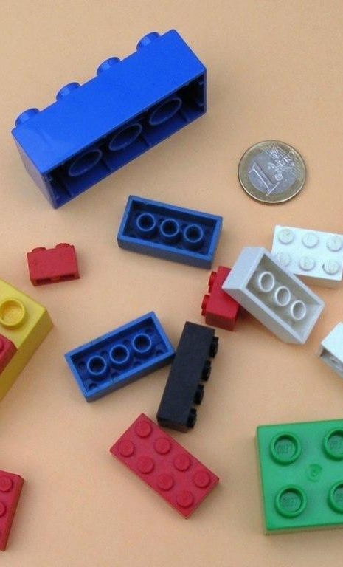
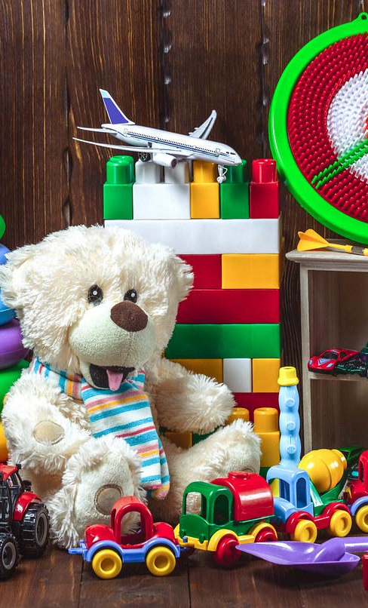
Scenario
Market Research
Real-time Interaction
Personalized Interactions
Unlike forms where respondents submit their answers and wait for analysis, your chatbot engages users in real-time conversations.
A chatbot can tailor its questions and responses based on the user's inputs, making the survey feel more personalized and relevant.

Slide 8
User-Friendly Interface
Engaging User Experience
Chatbots offer a conversational interface that's familiar to users, resembling natural conversations.
Conversations with chatbots can be more engaging than filling out traditional forms.

Slide 9
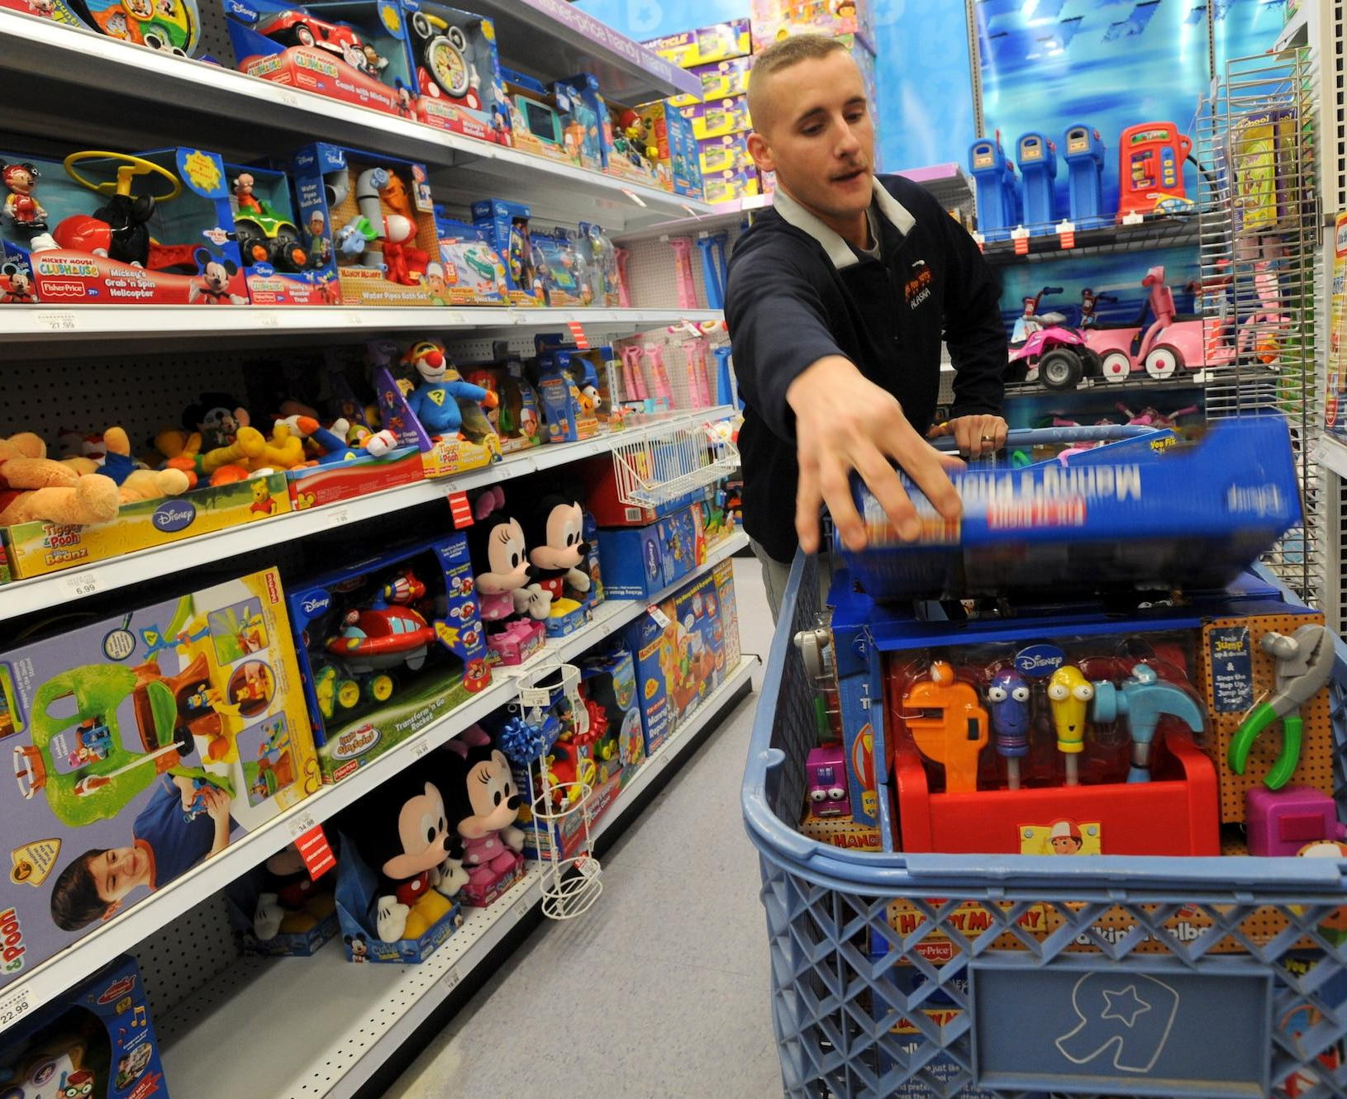
Scenario
Member Register
User Segmentation: By determining if a user is a regular customer or a wholesaler, the business can segment its customer base. This allows for tailored marketing and service strategies for different customer groups.
Targeted Promotions: By offering discount codes to regular customers based on their kid's age and gender, the business can promote age- and gender-appropriate products, increasing the likelihood of sales.

Slide 10
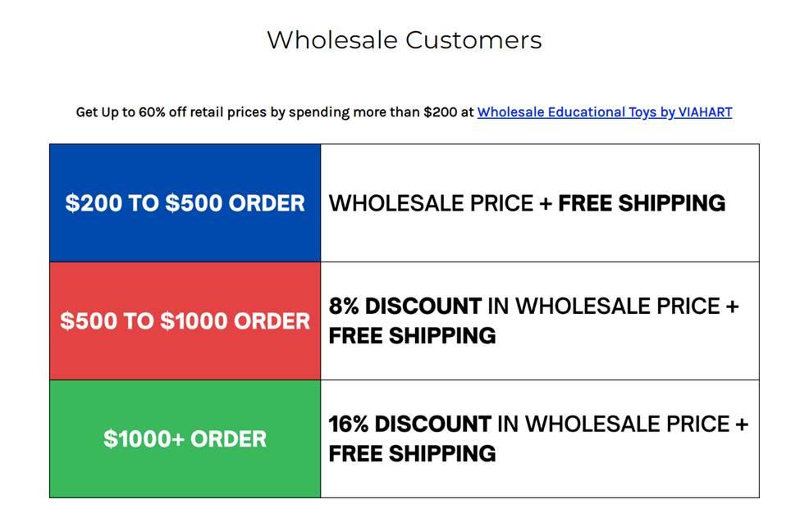
Scenario
Check out
Enhanced Customer Interaction: Enhance user engagement with instant answers to queries, and efficient product purchasing experience
Personalized User Experience: Offer personalized discounts based on user types (regular, wholesaler). Tailor responses and offers to individual preferences, building customer loyalty.
Different Price Calculation: Applying different preferential policies to calculate price for the customers according to their user type.
Scalability and Adaptability: Easily scale to handle increased user demand without proportional resource allocation

Slide 11
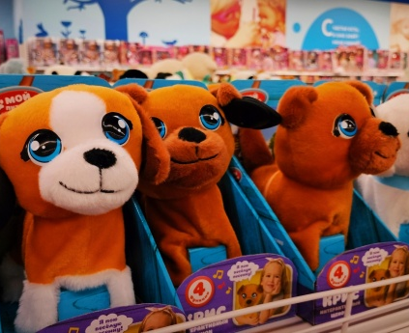
Scenario
Return
Improved Customer Experience: A smooth, quick, and hassle-free return process can greatly enhance customer satisfaction
Reduction in Human Error: Automated processes can reduce the chances of mistakes, such as providing wrong return labels or miscalculating refund amounts
Language & Accessibility: Chatbots can be programmed to support multiple languages and can be designed to be more accessible for people with disabilities

Slide 12
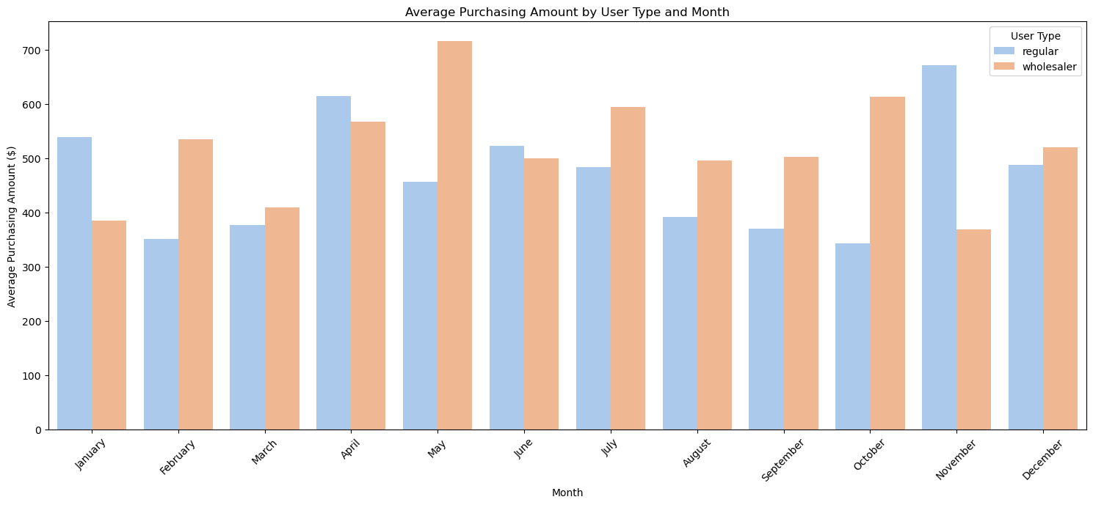
API View
Using Seaborn, we can depict the transaction data (generated through the chatbot) and gain more insights. This will help the retailer to visualize their various datasets. Example, visualize two types of customers their annual purchasing patter:

Slide 13
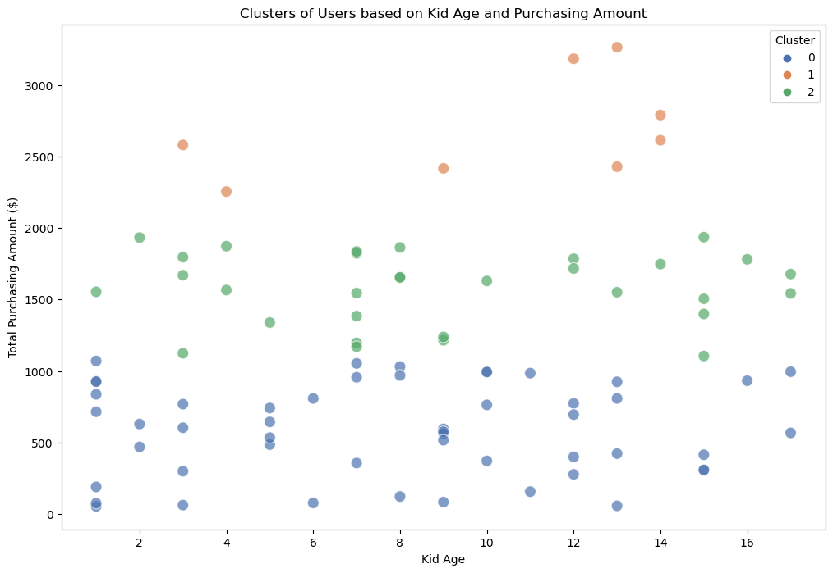
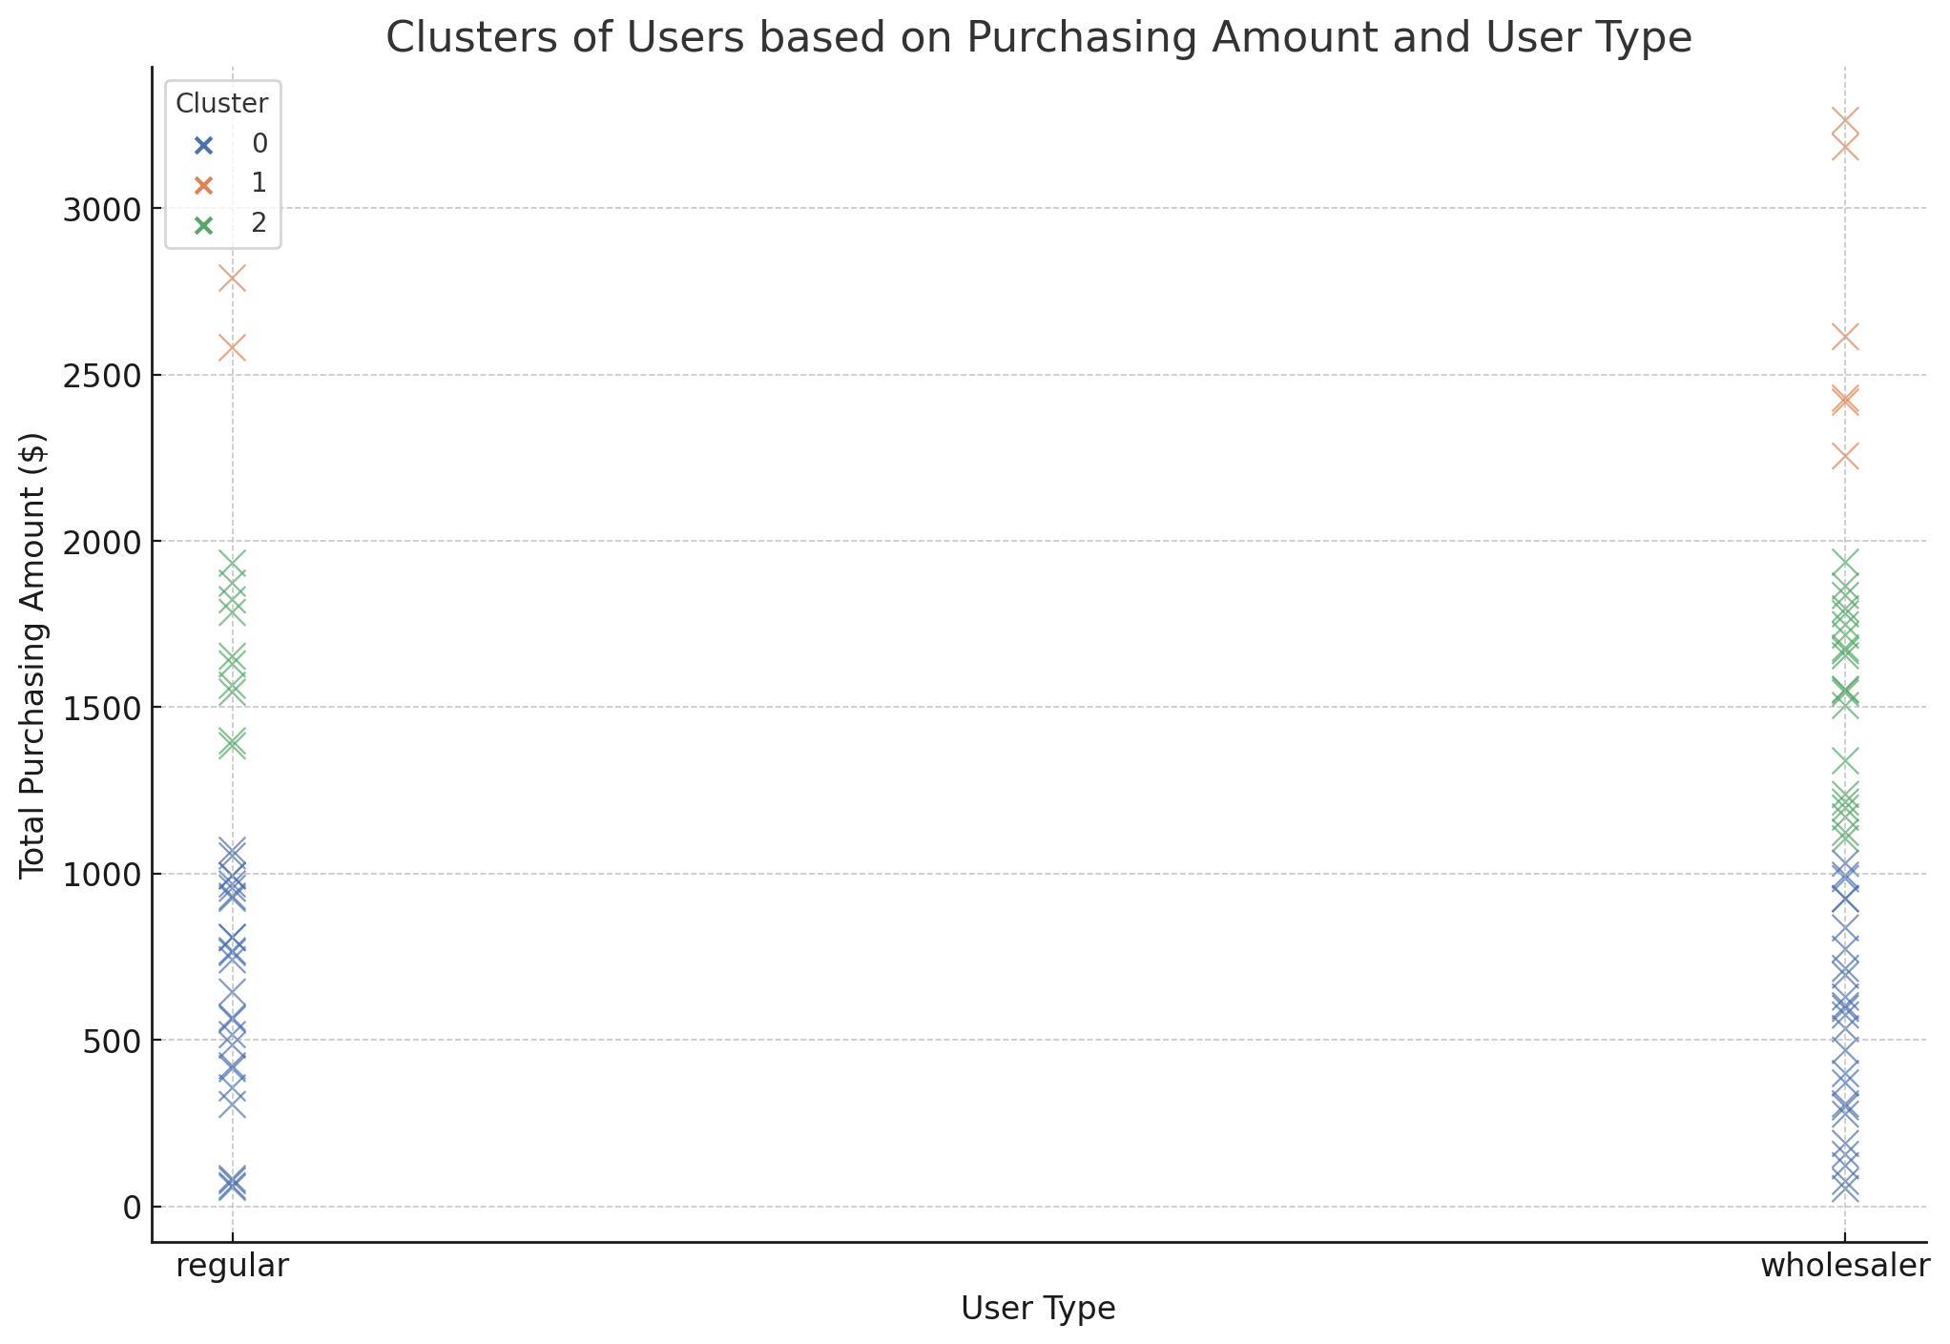
Using Sklearn, we can apply additional algorithms to potentially gain more insights on customer profile. Here is an example with clustering algorithms, focusing on kid_age, purchasing_amount and user_type. This can help the retailer gain more insights regarding their customer groups besides the traditional customer type segmentation:

Slide 14

Code Demo

Slide 15
Conclusion
In this project, we utilized chatbot to deal with multiple situations that a toy seller may encounter in their daily operations, including making transactions, registering new members, returns and conducting market research. The utilization of chatbot significantly reduces the operational cost as well as promoting the consumer experience. Moreover, we used API and sklearn to process and access the data collected from the operations, providing insights for the company to make decisions regarding marketing strategies and product development. The code can be further extended in the future to include more APIs such as Amazon to gather all the data the retailer has and store them into one single place. We firmly believe that with the implementation of chatbot, the status of the company will be greatly improved.

Slide 16
Thank You!

